Slide 1


A Quantitative and Qualitative Comparison Across Cloud Platforms on Sentiment Analysis Application
Kefei Wu (kw2669)
Sonal Sharma (ss13449)

Slide 2
Background
Suppose you are a developer in a startup involved with sentiment analysis experiments, what/how would you choose?
Text Analysis API provided by cloud platforms
Customize models with my own datasets (labeled?)
Utilize the trained model offered by platforms
AutoML
Train my own model
Deploy model as service to integrate into the original application
‹#›
Notes:
https://www.altexsoft.com/blog/datascience/comparing-machine-learning-as-a-service-amazon-microsoft-azure-google-cloud-ai-ibm-watson/
https://www.ssa-data.com/blog/archive/top-machine-learning-tools-comparison/

Slide 3
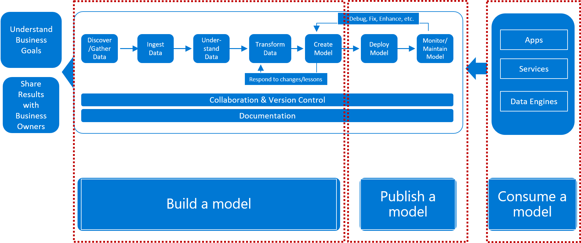
Introduction
MLaaS | AWS | Azure | GCP | IBM
Classification | ✅ | ✅ | ✅ | ✅
Regression | ✅ | ✅ | ✅ | ✅
Clustering | ✅ | ✅ | ❌ | ❌
Recommendation | ❌ | ✅ | ✅ | ❌
Anomaly Detection | ❌ | ✅ | ❌ | ❌
Ranking | ❌ | ✅ | ❌ | ❌
PaaS | AWS Sagemeker | Azure ML | Google ML | IBM watson studio
Built-in Algorithm | ✅ | ❌ | ✅ | ✅

Slide 4
Goals
What is the project about?
Comparing Machine Learning as a Service with Amazon, Microsoft Azure through a sentiment analysis application
Define the goal of the project.
Summarize the advantages, disadvantages, use cases of Amazon, Microsoft Azure MLaaS from a developer’s view
Define the scope of the project.
Sentiment Analysis API Comparison
Model training comparison
Model deploying comparison
*
‹#›
Notes:
https://www.altexsoft.com/blog/datascience/comparing-machine-learning-as-a-service-amazon-microsoft-azure-google-cloud-ai-ibm-watson/
https://www.ssa-data.com/blog/archive/top-machine-learning-tools-comparison/

Slide 5
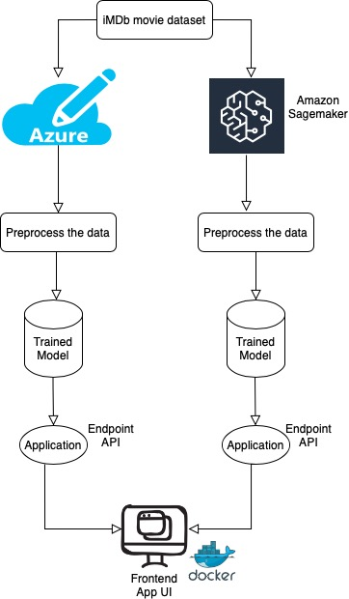
Sentiment Analysis Application - Architecture

Slide 6
Sentiment Analysis Application - Data Preprocessing
Dataset：iMDb movie review
Step 1 : remove html tags using BeautifulSoup
 | review | sentiment
count | 50000 | 50000
unique | 49582 | 2
top | Loved today's show!!!... | positive
freq | 5 | 25000
Step 2 : remove non-character such as digits and symbols
Step 3 : convert to lower case
Step 4 : remove stop words such as "the" and "and" if needed
Step 5 : convert to root words by stemming if needed
random sample: 10%(5000) data
4500 training examples
500 validation examples

Slide 7
Sentiment Analysis Application - Models
Bag of Words
step 1
step 2
step 3
step 4
step 5
Preprocess raw reviews to cleaned reviews
Create BoW using CountVectorizer / Tfidf vectorizer in sklearn
Transform review text to numerical representations (feature vectors)
Fit feature vectors to supervised learning algorithm
(eg. Naive Bayes, Logistic regression)
Improve the model performance by GridSearch
Word2Vec
step 1
step 2
step 3
step 4
Parse review text to sentences (Word2Vec model takes a list of sentences as inputs)
Create vocabulary list using Word2Vec model.
Transform each review into numerical representation by computing average feature vectors of words therein.
Fit the average feature vectors to Random Forest Classifier.

Slide 8
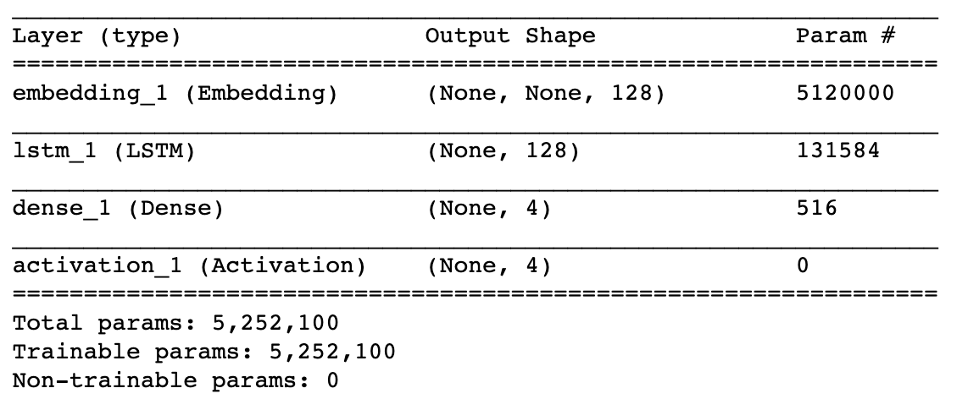
Sentiment Analysis Application - Models
LSTM
step 1
step 2
step 3
Tokenize input data: prepare X_train and X_test to 2D tensor
Train a simple LSTM (embedding layer => LSTM layer => dense layer)
Compile and fit the model using log loss function and ADAM optimizer.

Slide 9
Sentiment Analysis Application - Models
Model | Description | Accuracy
Countvectorizer with Multinomial Naive Bayes | Number of features : 36751 MultinomialNB(alpha=1.0, class_prior=None, fit_prior=True) | 0.8140
Tfidf Vectorizer with Logistic Regression | Number of features : 10505 LogisticRegression(C=1.0, class_weight=None, dual=False, fit_intercept=True, intercept_scaling=1, l1_ratio=None, max_iter=100, multi_class='auto', n_jobs=None, penalty='l2', random_state=None, solver='lbfgs', tol=0.0001, verbose=0, warm_start=False) | 0.8500
Word2Vec with Random Forest Classifier | Number of words in the vocabulary list : 6945 Training set : 4500 feature vectors with 300 dimensions Validation set : 500 feature vectors with 300 dimensions | 0.7640
LSTM | embedding layer => LSTM layer => dense layer Compile and fit the model using log loss function and ADAM optimizer. | 0.8750

Slide 10
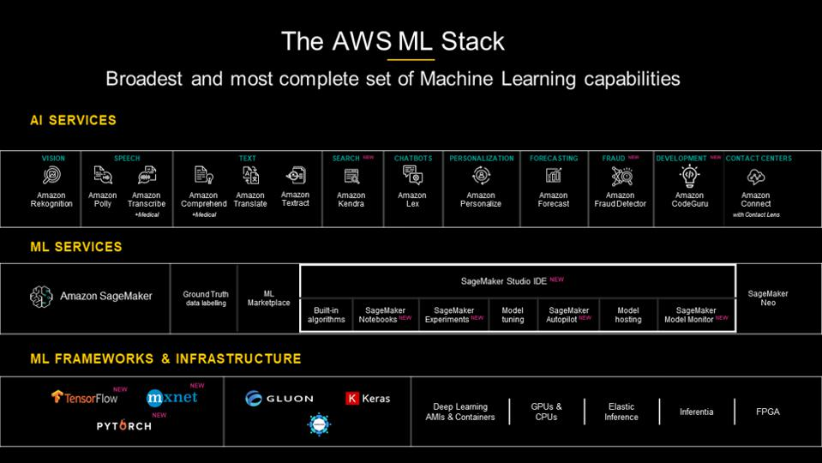
Sentiment Analysis Application - AWS ML Stack

Slide 11

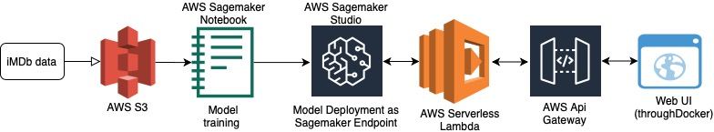
AWS Model Deployment Process

Slide 12
AWS Model Training Metrics
Model | Wall time | CPU time | Time per epoch | Memory | Accuracy on validation set | AUC
CountVectorizer with Multinomial Naive Bayes | 1.15 s | user 1.12 s sys: 10.2 ms total: 1.13 s | - | Peak memory: 1935.25 MiB Increment: 0.23 MiB | 0.8140 | 0.8142
Tfidf Vectorizer with Logistic Regression | 1.03 s | user 1.12 s sys: 0 ns total: 1.12 s | - | Peak memory: 1944.39 MiB Increment: 0.00 MiB | 0.8500 | 0.8500
Word2Vec with Random Forest Classifier | 55.6s | user 56.7 s sys: 0 ns total: 56.7 s | - | Peak memory: 2040.82 MiB Increment: 0.00 MiB | 0.7620 | 0.7620
LSTM | 2min 19s | user 3min 57s sys: 15.2 s total: 4min 13s | 22s | Peak memory: 2772.10 MiB Increment: 1647.09 MiB | 0.8890 | 0.8890

Slide 13
Azure ML Overview
For newcomers
Graphical interface to visualize each step within the workflow，
Collection of machine learning solutions provided by the community
ML Studio
Cortana Intelligence Gallery
Azure Machine Learning platform
Azure ML Workspaces
For experienced developers
Web interface to deploy models, visualize data, and work on dataset preparation
Python Machine Learning SDK
Released 2019

Slide 14
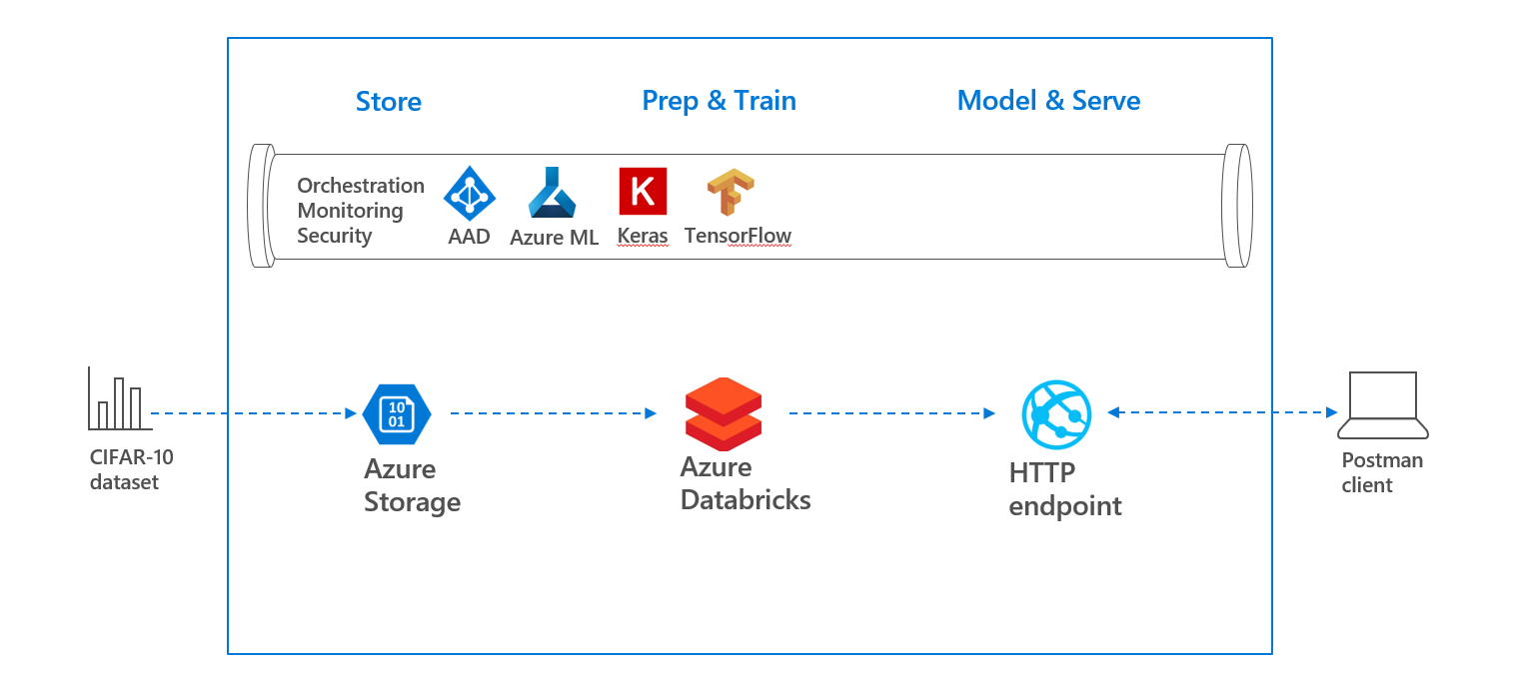
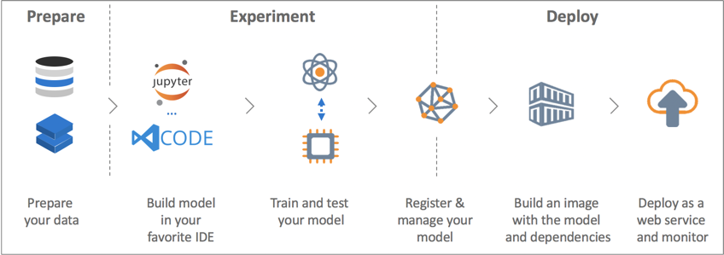
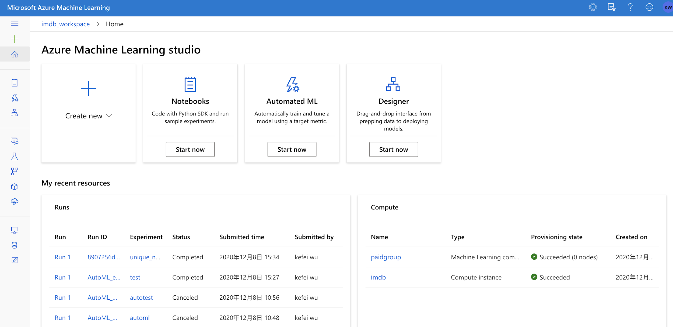
Azure ML Workspace with python SDK
Experimentation.
support for main frameworks
historic configuration
Workbench Dashboard
Model management.
CI / CD
on Azure, on-premises, edge devices.
Visual Studio Tools for AI.

Slide 15
Azure ML Model Training Metric
Model | Wall time | CPU time | Memory | Accuracy on validation set | AUC
CountVectorizer with Multinomial Naive Bayes | 1.02 s | user 1.03 s sys: 0 ms total: 1.03 s | Peak memory: 3365.85 MiB Increment: 0.00 MiB | 0.8140 | 0.8142
Tfidf Vectorizer with Logistic Regression | 3.11 s | user 7.09 s sys: 2.51 s total: 9.6 s | Peak memory: 3365.37 MiB Increment: 0.02 MiB | 0.8500 | 0.8500
Word2Vec with Random Forest Classifier | 52s | user 52.3 s sys: 0 ns total: 52.3 s | Peak memory: 2040.82 MiB Increment: 0.00 MiB | 0.7620 | 0.7620
LSTM | 2min 19s | user 3min 57s sys: 15.2 s total: 4min 13s | Peak memory: 2772.10 MiB Increment: 1647.09 MiB | 0.8890 | 0.8890

Slide 16
Azure ML Model Deployment Process
Consume the web service
RESTful API for C#, Java, Go and Python, no Javascript
Prepare an inference configuration
define the environment and packages the model needs
05
Deploy the model to the compute target
1 CPU and 1 memory_gb
01
04
Prepare an entry script
Loading model using an init()
Running model using a function run())
Choose a compute target
Azure Container Instances
Local websites to test and debug
Azure Kubernetes Service for Real-time inference
Azure Machine Learning compute clusters for Batch inference
02
03

Slide 17
Sentiment Analysis Application - DEMO
DEMO

Slide 18
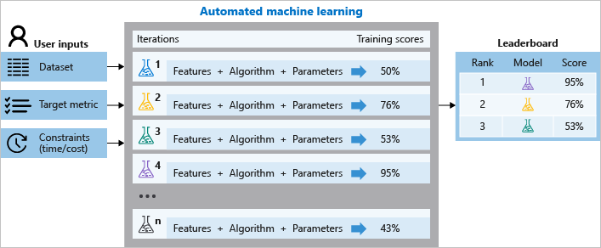
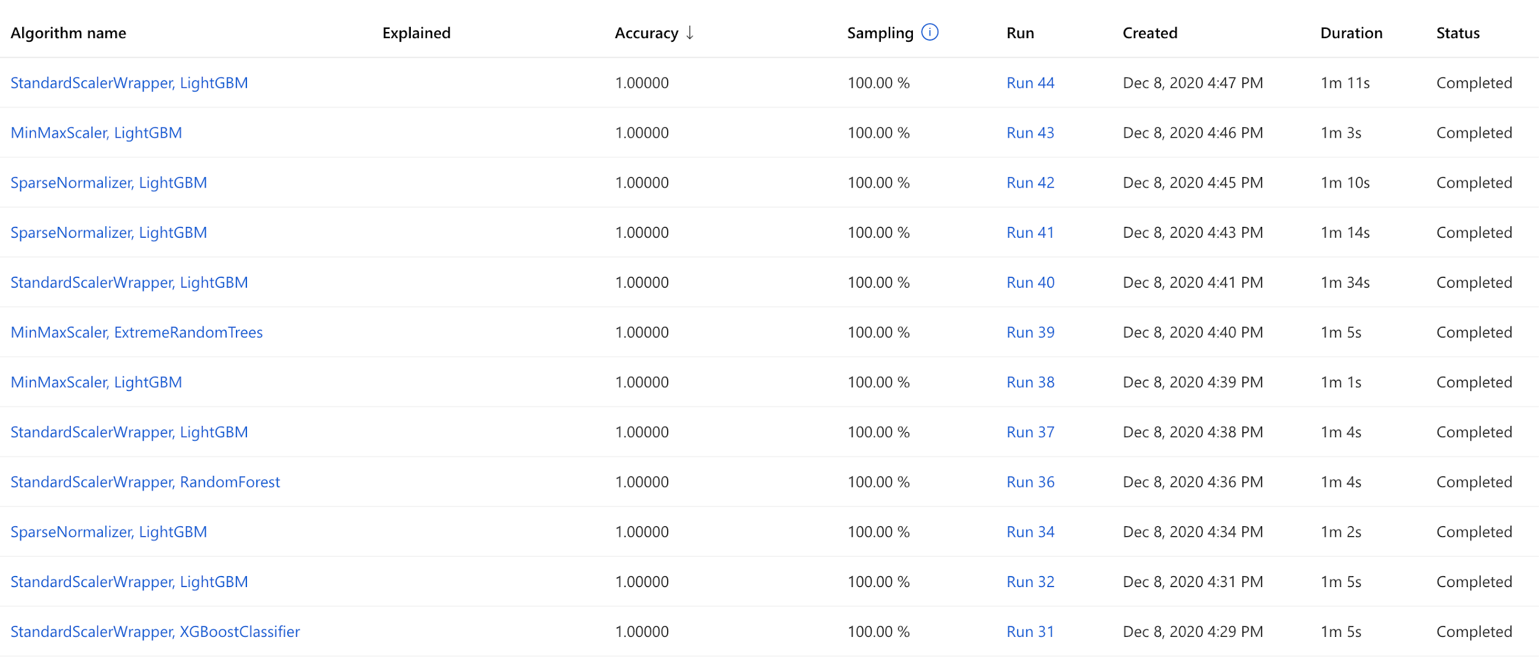
Azure AutoML
Create Datasets
Identify feature columns and target column
Configure experiment run
Computing settings, Task type, Target metrics, Concurrency…
Task type: Classification, Regression, Time-series Forcasting
Explore and deploy models
clean up resources

Slide 19
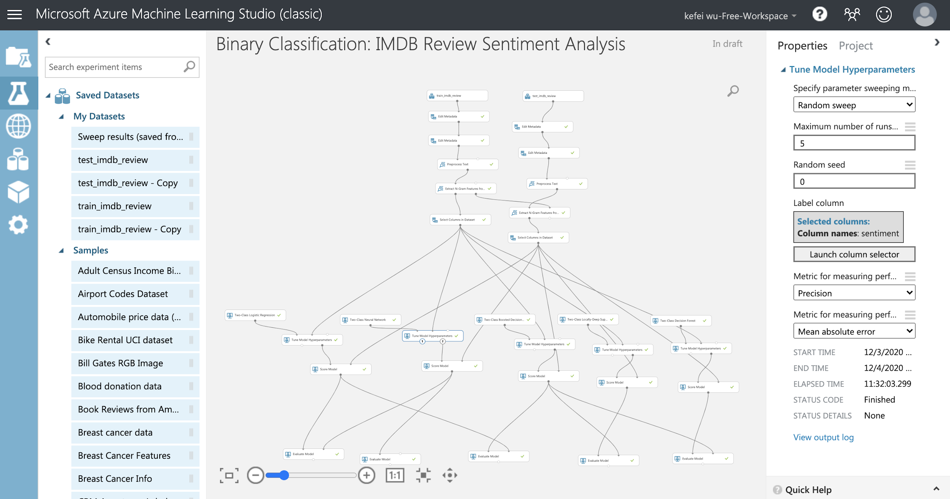
Azure ML Studio

Slide 20
Azure ML Studio
Model (BoW) | Epochs | Hyperparameters for Trained best model
Logistic Regression | 3 | OptimizationTolerance = 0.000028, L1weight = 0.496711, L2weight = 0.96395, Memorysize = 6
Neural Network | 5 | Learning rate = 0.3544, LossFunction = SquaredError, Number of iterations = 21
Random Forest | 50 | Min samples per leaf node = 3, Random splits per node = 98, Max depth = 12, decision trees = 25
Model | Training Time | Accuracy | Precision | Recall | F-Score | AUC | Avg Log Loss | Training Log Loss
LR | 3.11 s | 0.8500 | 0.8500 | 0.8500 | 0.8500 | 0.8500 | 0.4357 | 12.5643
LR | 30.316s | 0.76996 | 0.761285 | 0.78656 | 0.773716 | 0.84487 | 0.494765 | 28.6205
NN | 11h32min | 0.74184 | 0.719759 | 0.79208 | 0.75419 | 0.81671 | 0.907074 | -30.86317
RF | 7min31s | 0.72004 | 0.70937 | 0.74552 | 0.726996 | 0.79469 | 0.649241 | 6.334262
Neural Network: 1 Hidden Layer with 2x2500 nodes - Loss Function: tanh

Slide 21
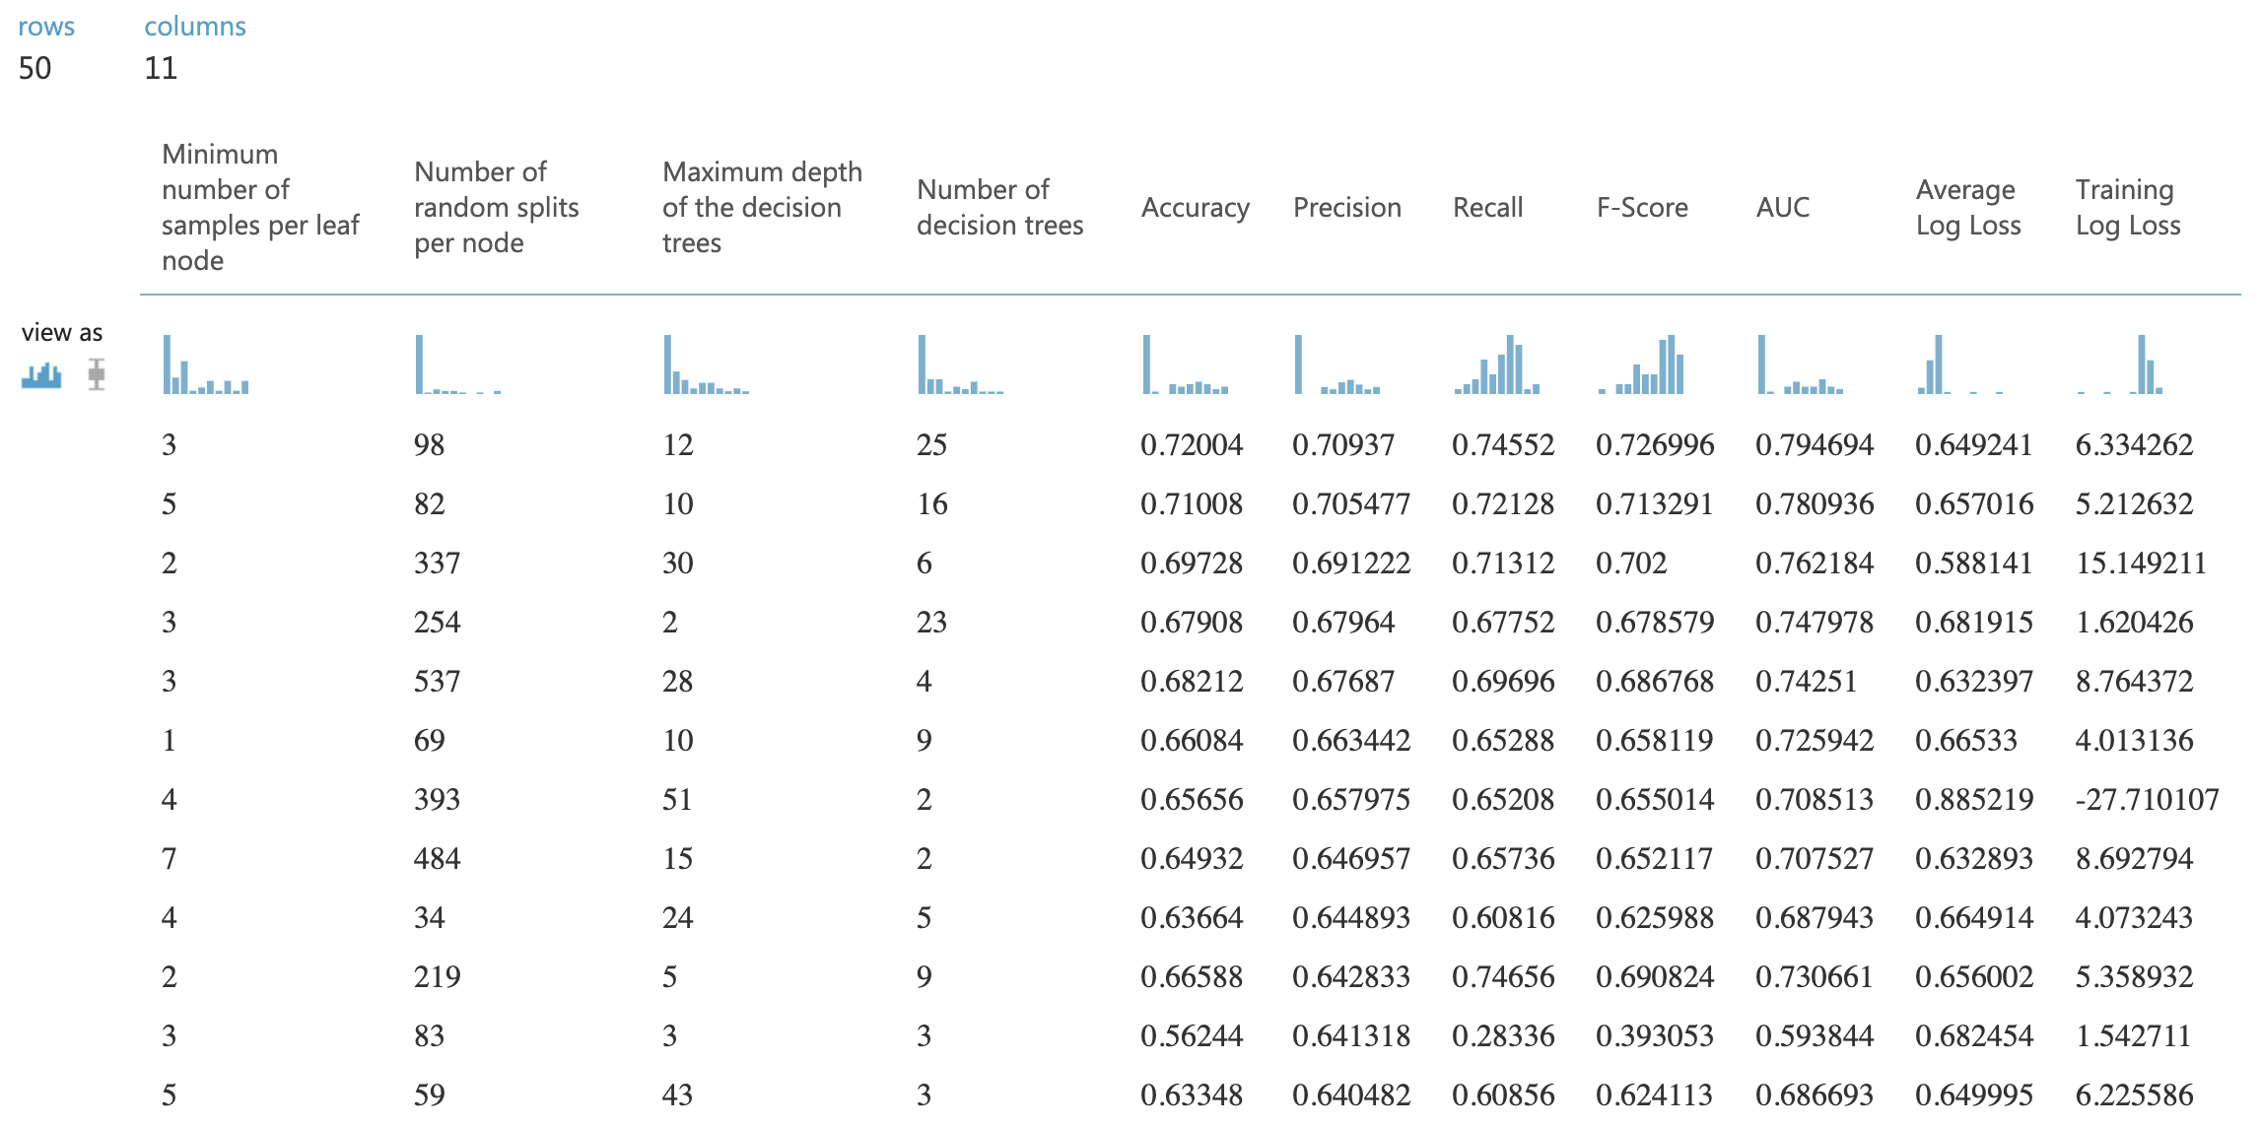
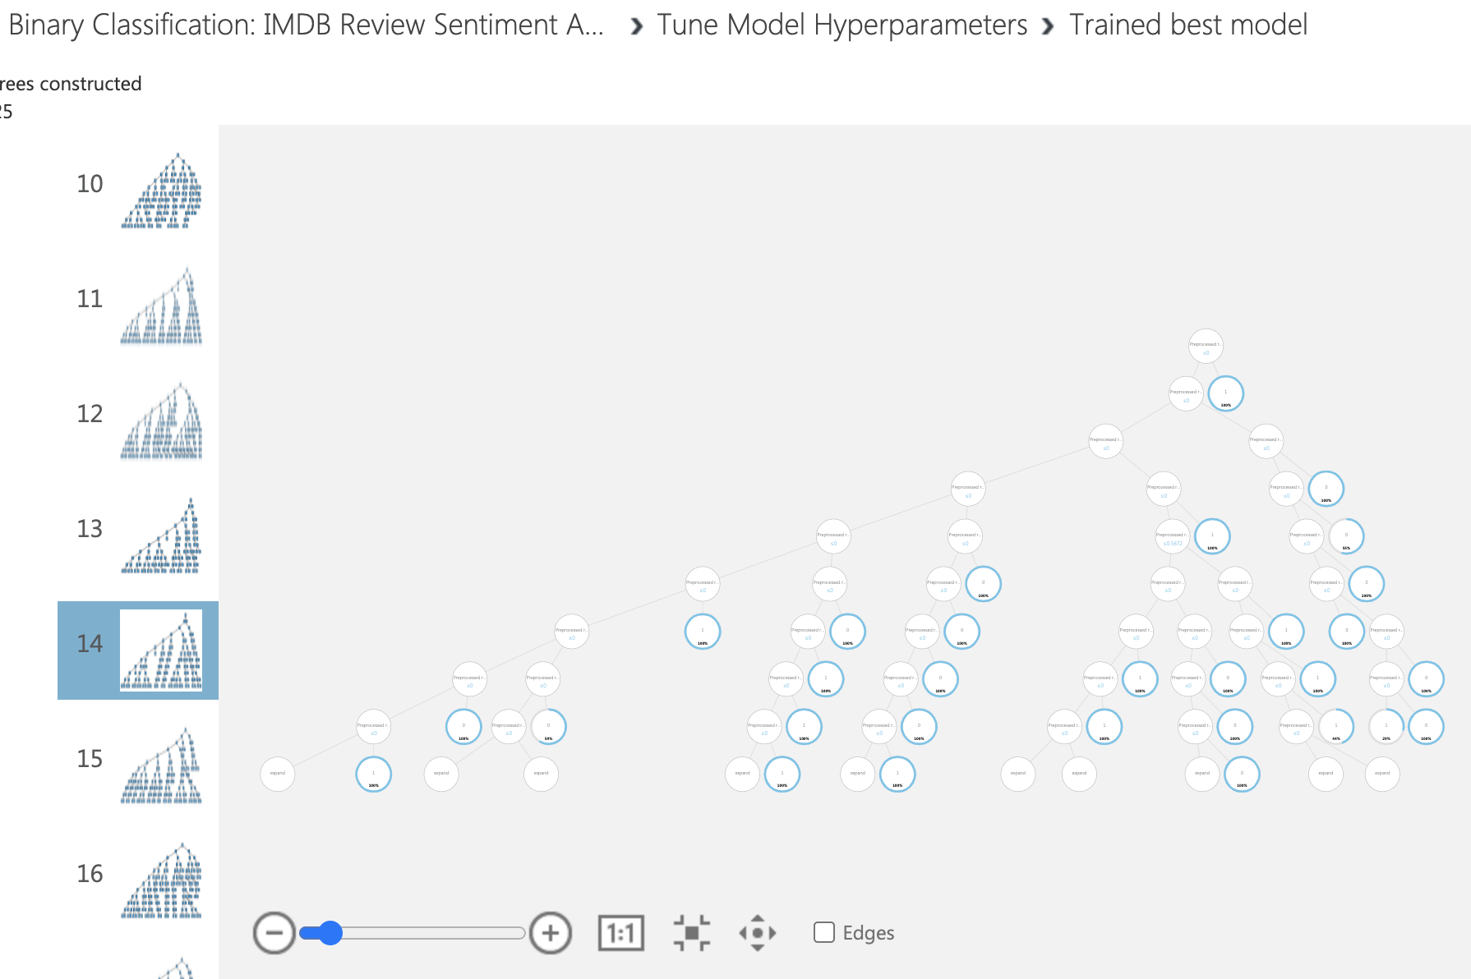
Azure ML Studio

Slide 22
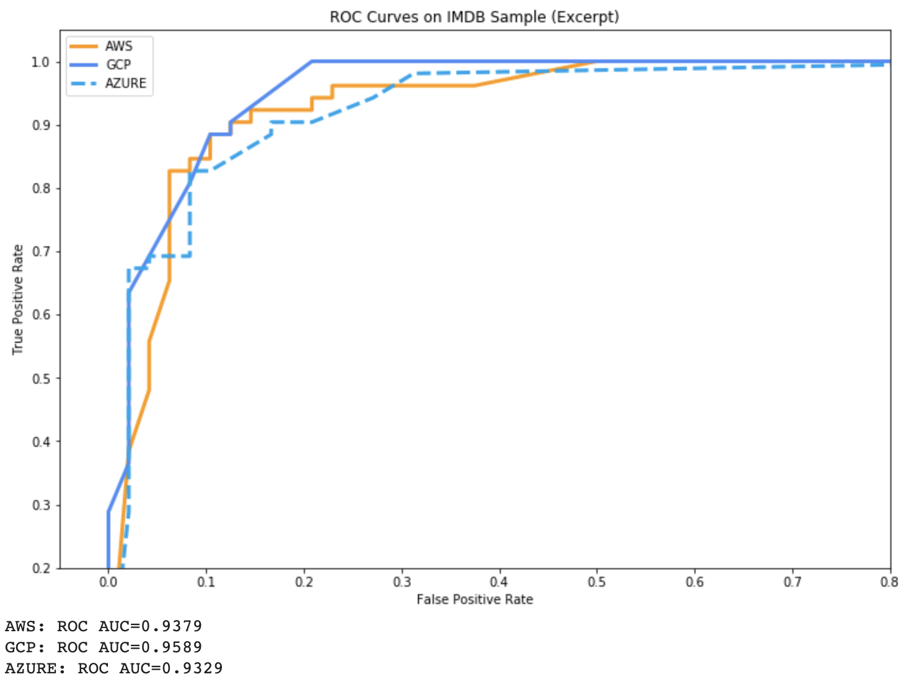
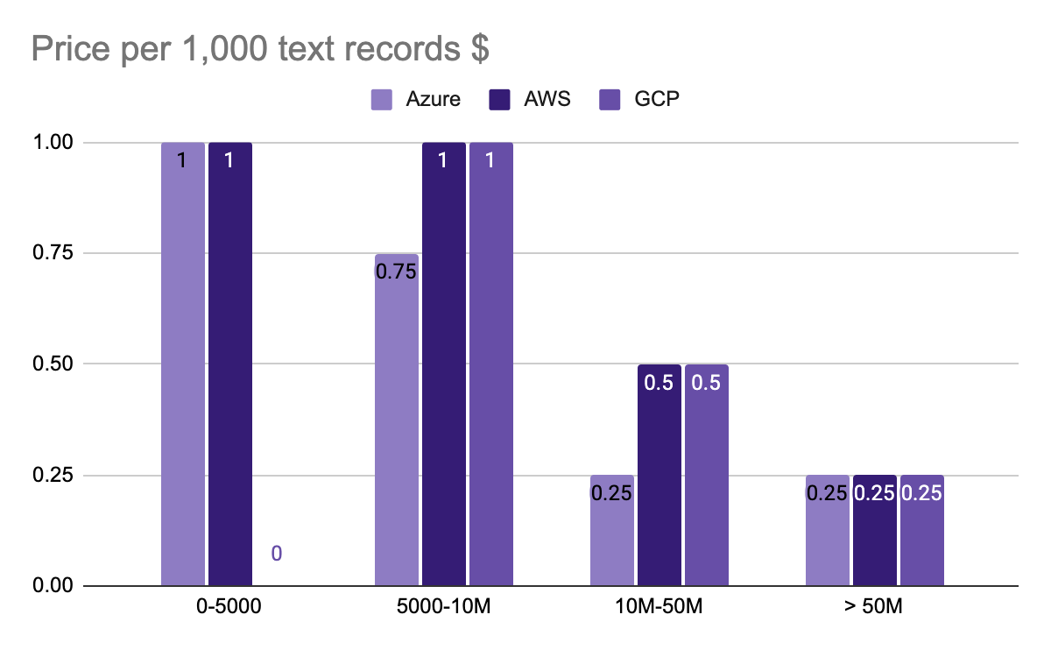
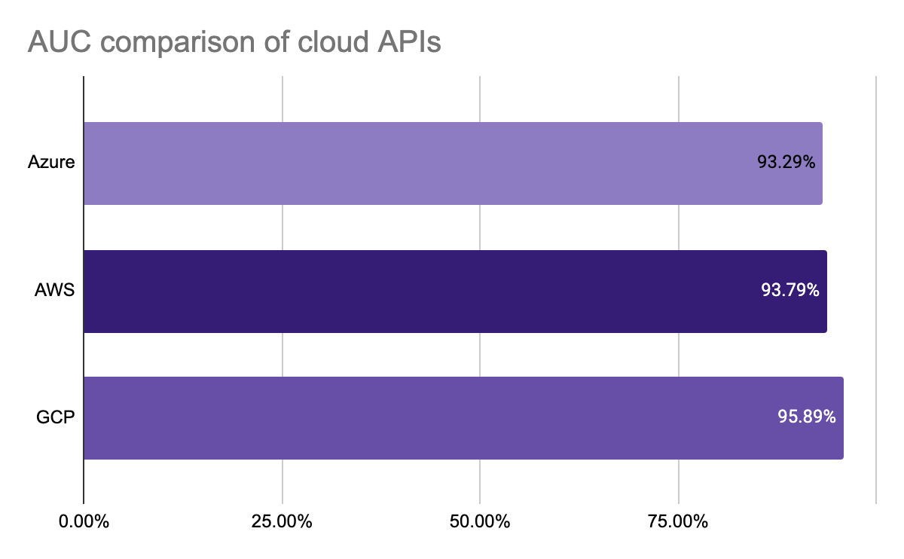
Sentiment Analysis API Comparison
AWS Comprehend vs Azure cognitive services vs GCP Cloud Natural Language
GCP: wins best Accuracy,
free for request < 5000
Azure cognitive: One API for all ML
AWS: most powerful for huge requests

Slide 23
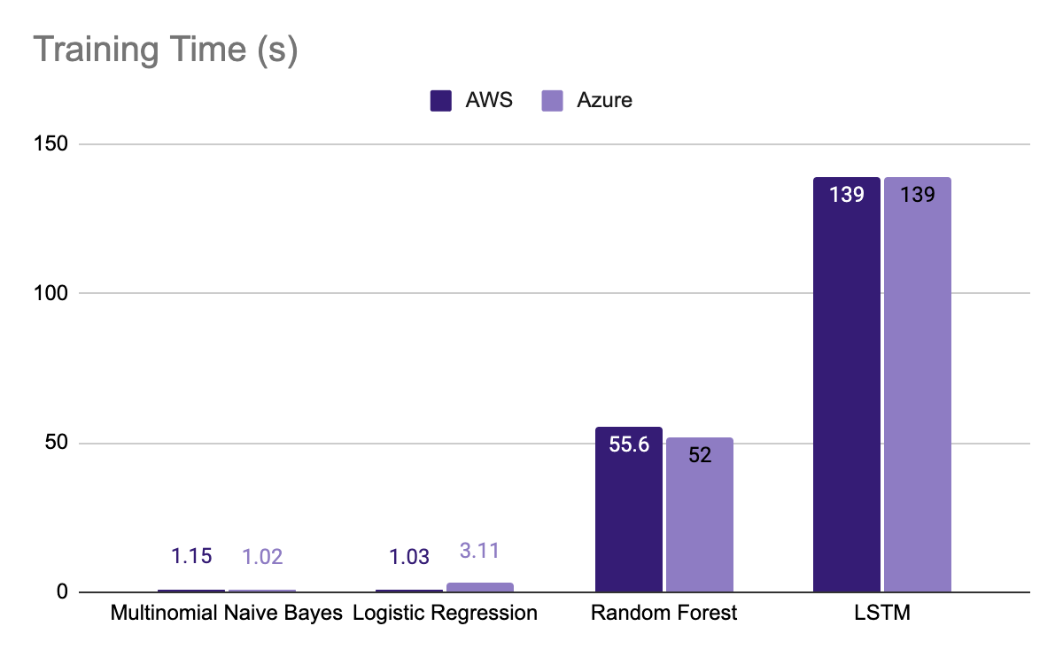
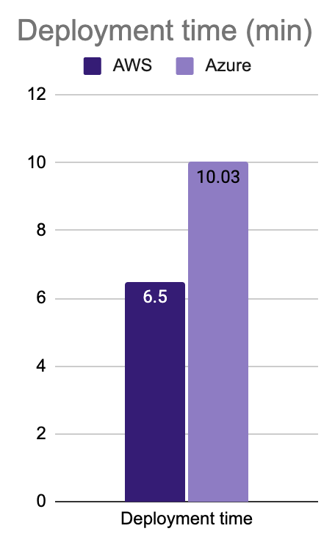
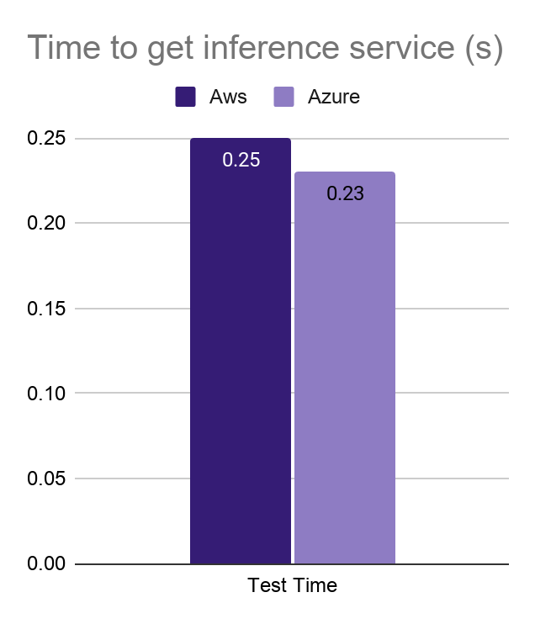
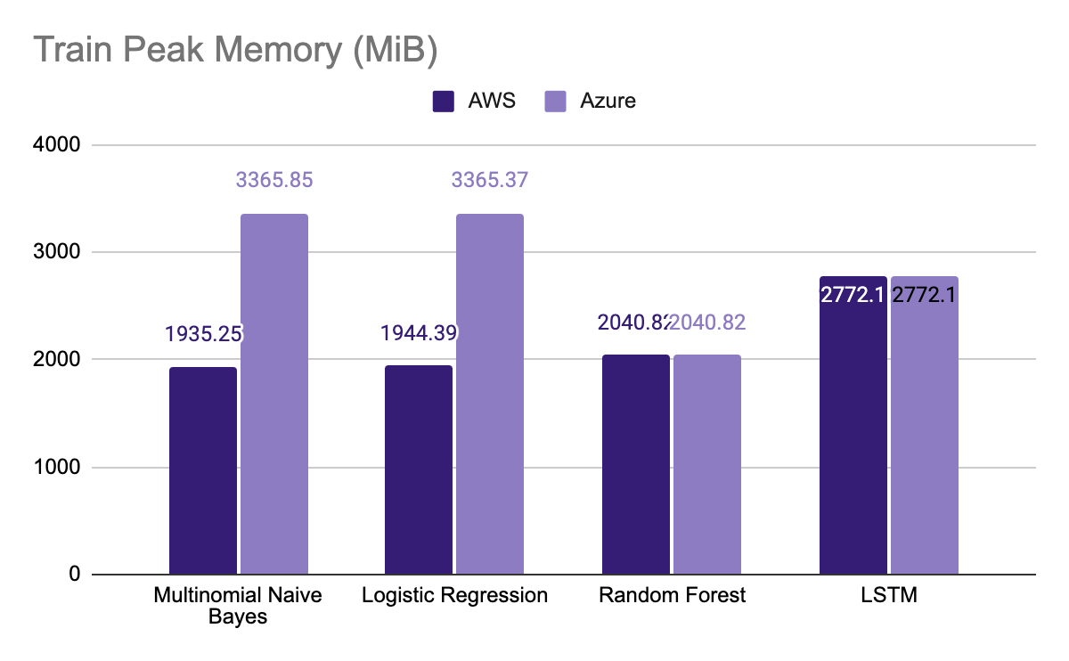
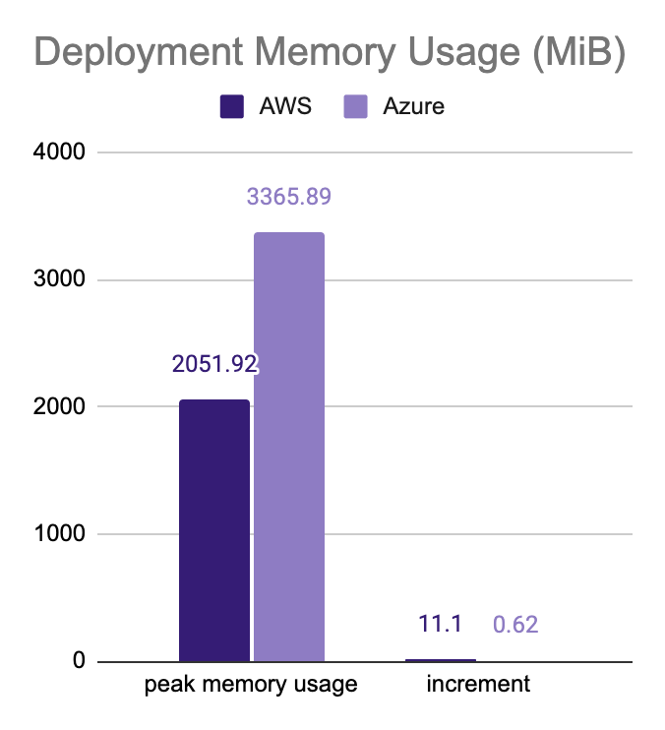
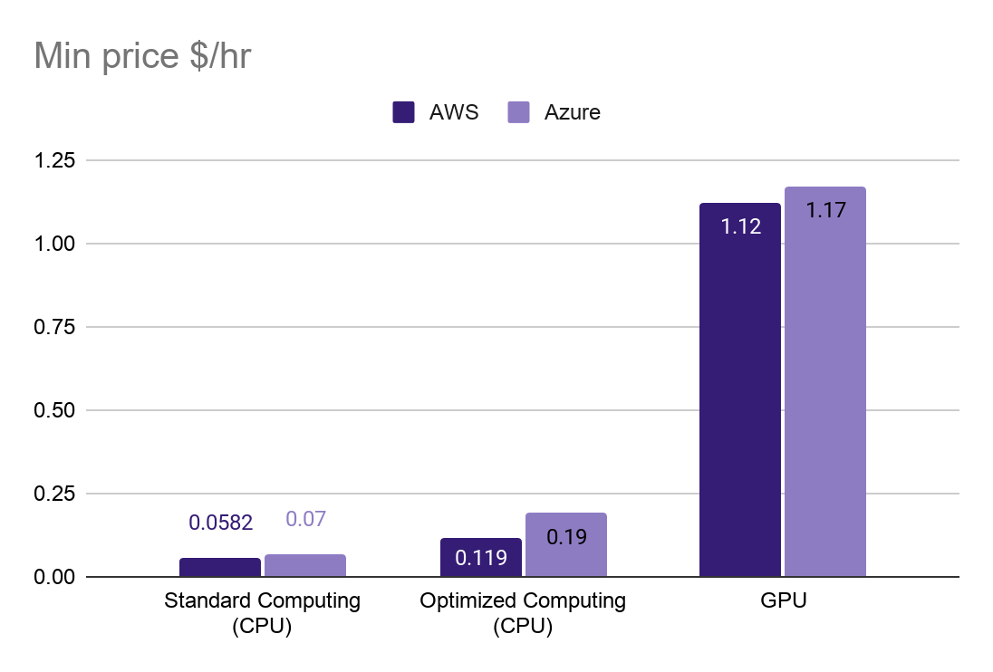
Quantitative Comparison

Slide 24
Qualitative Comparison
 | AWS |  | Azure
 | Pros | Cons | Pros | Cons
ML Platforms | Comprehensive Documentation Fully Scalable, on-demand, Managed Infrastructure Distributes inference compute by deploying Endpoints Notebooks (examples of popular algorithms) Rich marketplace | Expensive! Knowledge of coding and Data Engineering processes is required May/may not be suitable for beginners No scheduled training job Expensive! | Drag-and-Drop UI Suitable for beginners Automated and Semi- automated ML services (anomaly detection, recommender system, ranking) More flexible with Algorithms Easily combined with C#, .Net service | RESTful API does not support AJAX request No built-in algorithm support in PaaS Relative longer deployment time Scenario-based documentation, unclear text tips for error
On-demand Pricing | Billed for the duration for use (per hour) $0.28/hr (ml.m4.xlarge 4 CPU, 16GB RAM) |  | Billed for the duration for use (per hour) $ 0.08/hr (standard computing, 1 CPU 3.5 GB RAM)
Notes:
newcomers: can get start very quickly with Graphic UI
Data Analyst with limited machine learning experience: AutoML
Azure cognitive API: one API for all services, including computer vision, speech-to-text and so on

Slide 25
Improvements
Host the Web-API on another cloud through docker containers
How to scale our service, realtime inference, batch inference
Model Accuracy needs improvement
What if the data is not labeled? Auto label?
MLOps: Model management

Slide 26
Improvements
Q&A

